Slide 1
GLOBAL COVID-19
a detailed analysis of global Covid-19 trends, fatality rates, and policy measures (2020-2025).
Uchechukwu okonkwo

Slide 2
RESEARCH QUESTIONS
THEME A: GLOBAL INTENSITY
What were the overall cases and fatalities recorded due to Covid?
What year had the highest number of cases?
In what year did the most deaths occur?
How frequent were there new fatalities and cases?
What was the average reproduction rate recorded?
THEME B: GEOGRAPHIC IMPACT
What was the mortality rate in each continent, and which continent was most affected?
What countries had the highest mortality rate?
THEME C: GLOBAL RESPONSE & PREVENTION
How strict overall were government policies regarding the pandemic? (Stringency Index)
What could we note about the number of cases in countries with stricter policies and their death rate as well? Did their high Stringency Index contribute to lowering the deaths and new cases, or did it not help?
Were there enough vaccinations available for prevention?

Slide 3
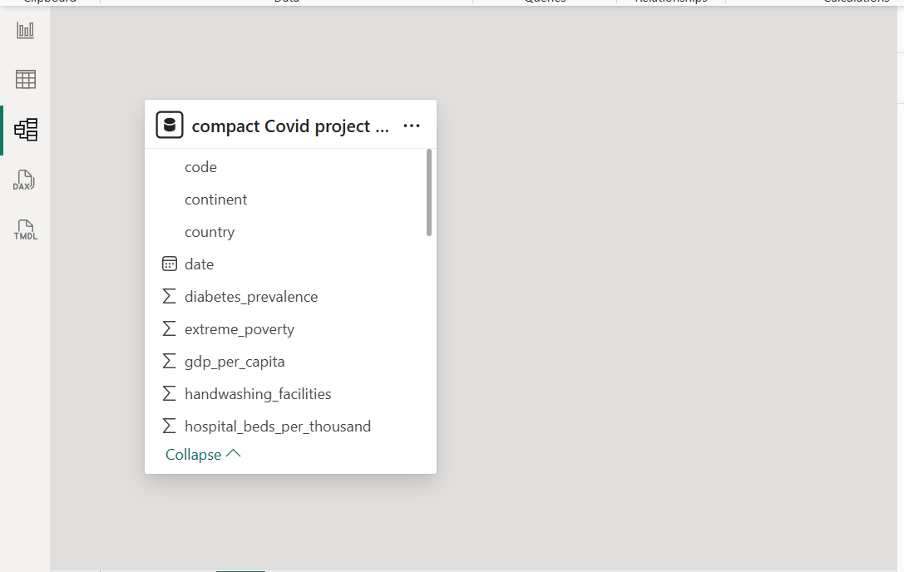
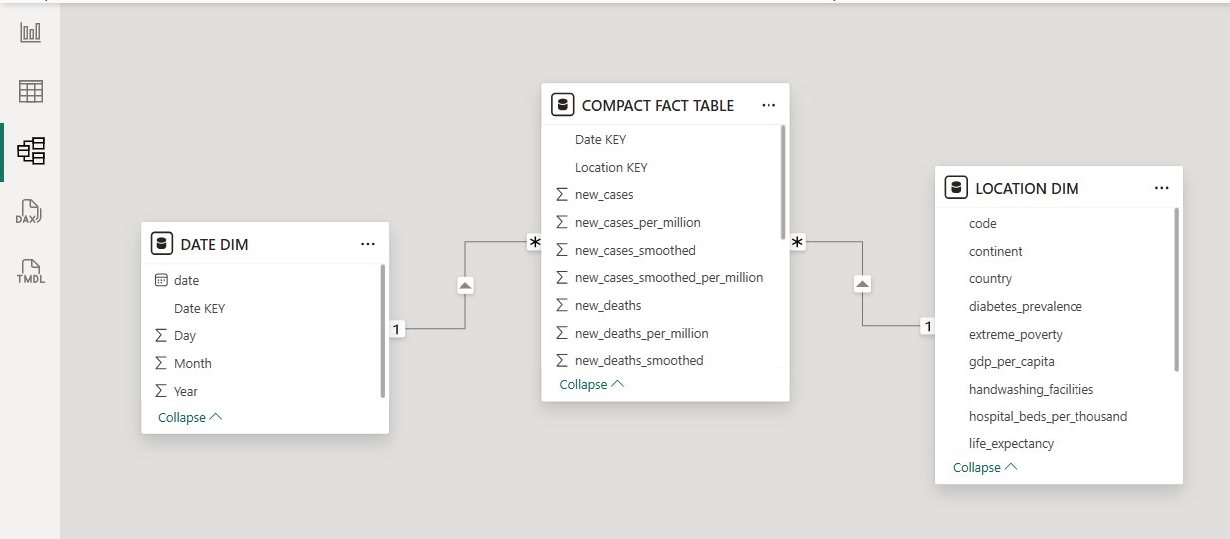
DATA MODEL
Before Modelling
After Modelling

Slide 4

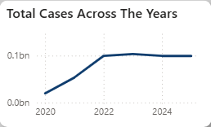
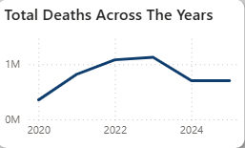

THEME A: GLOBAL INTENSITY
What were the overall cases and fatalities recorded due to Covid?
What year had the highest number of cases?
In what year did the most deaths occur?
The overall cases recorded were:
While the overall recorded deaths were:
These values show there was a 1.09% case fatality rate.
From the trends chart it was noted that the year 2023 had the most cases recorded with an estimated over 103 million cases recorded.
It was noted from the trends chart, that the year 2023 had the most recorded deaths with an estimated value of over 1.1 million deaths recorded.

Slide 5
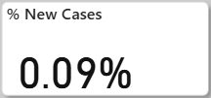
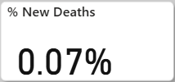

THEME A: GLOBAL INTESITY
How frequent were there new fatalities and cases?
These low ratios indicate that during the period under review, the incidence of new infections and deaths was relatively infrequent.
What was the average reproduction rate recorded?
The average reproduction rate value across the period is below 1. This suggests a declining rate of transmission rather than an alarming spread.

Slide 6
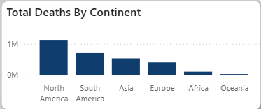
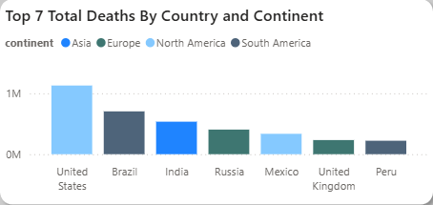
THEME B: GEOGRAPHIC IMPACT
What was the mortality rate in each continent, and which continent was most affected?
It could be noted from the visual that North America was most affected by the pandemic, followed by South America.
What countries had the highest mortality rate?
From the examination of the visual, United States had the highest mortality rate. The next most affected country was Brazil.

Slide 7

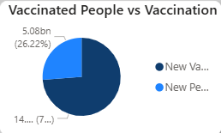
THEME C: GLOBAL RESPONSE & PREVENTION
How strict overall were government policies regarding the pandemic? (Stringency Index)
The average Stringency Index value of 42.9 suggests that the government was moderately strict on average. This suggests that while certain control measures were implemented, they were not among the most restrictive levels observed.
Were there enough vaccinations available for prevention?
The chart visualization indicates that the number of available vaccine doses exceeded the number of individuals vaccinated, suggesting that sufficient vaccination was available for prevention. This surplus may be attributed to factors related to vaccine availability or uptake.

Slide 8
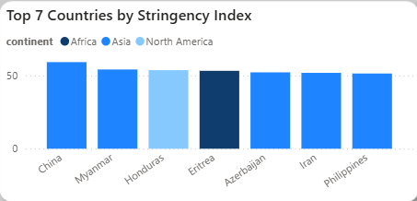
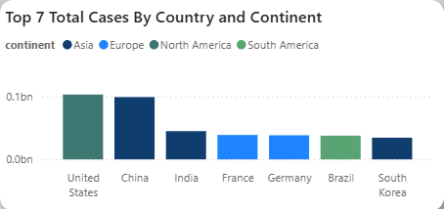
THEME C: GLOBAL RESPONSE & PREVENTION
What could we note about the number of cases in countries with stricter policies and their death rate as well? Did their high Stringency Index contribute to lowering the deaths and new cases, or did it not help?
An examination of the visuals indicates that countries with stricter government policies tended to record higher numbers of cases and death rates. This suggests that a higher Stringency Index may not have directly contributed to lowering infections or fatalities. Instead, it is likely that stricter policies were implemented in response to already elevated case and death figures, rather than being the primary cause of reduction.

Slide 9
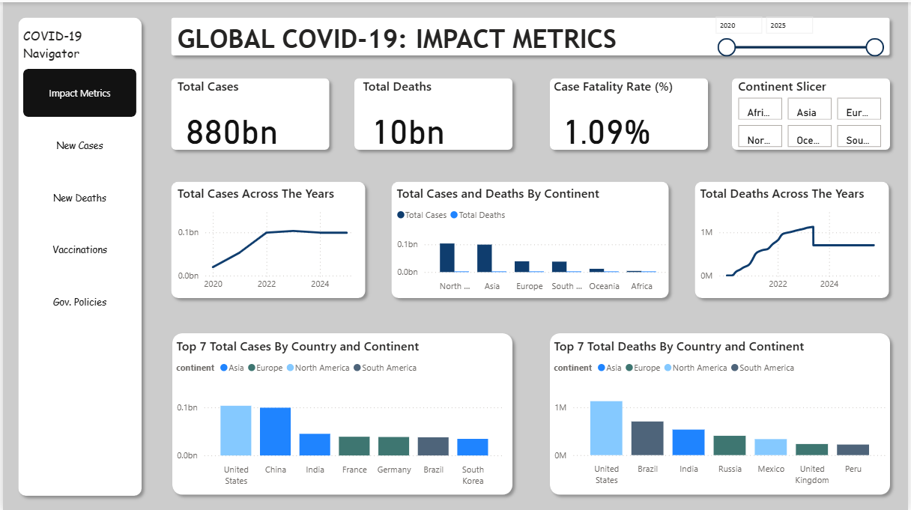
DASHBOARD PREVIEW

Slide 10
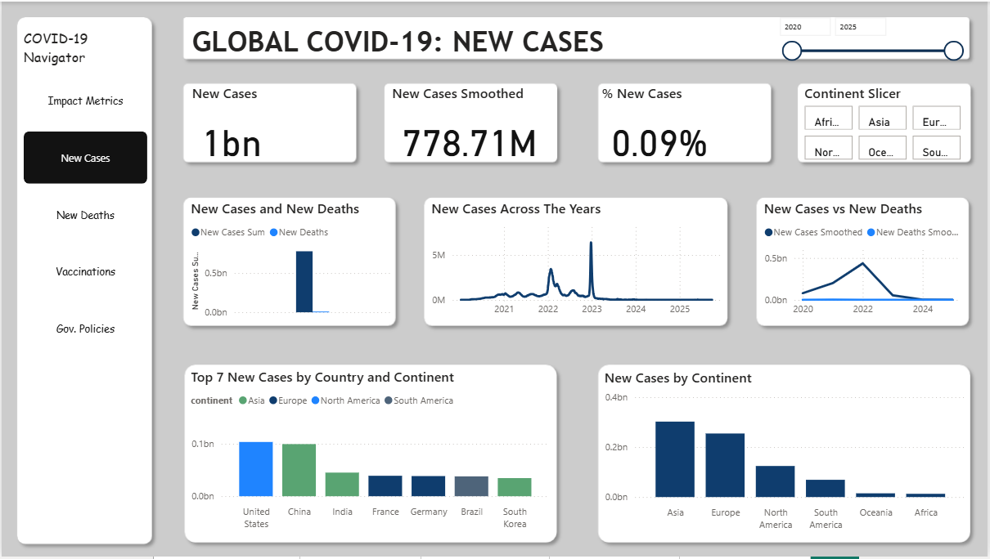
DASHBOARD PREVIEW

Slide 11
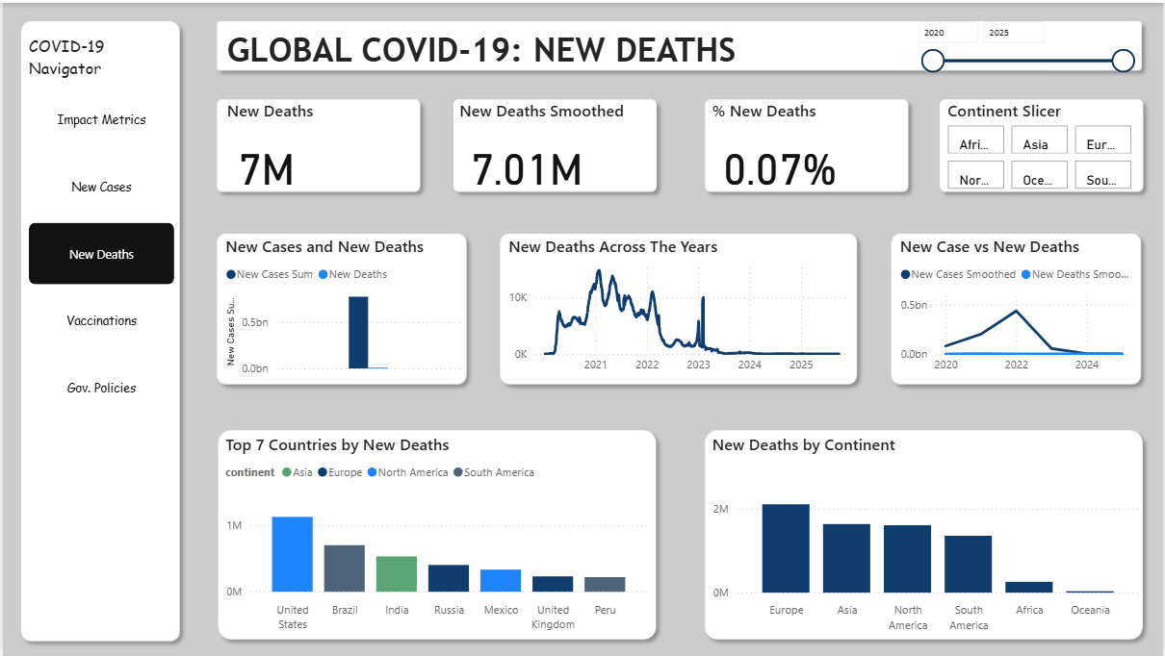
DASHBOARD PREVIEW

Slide 12
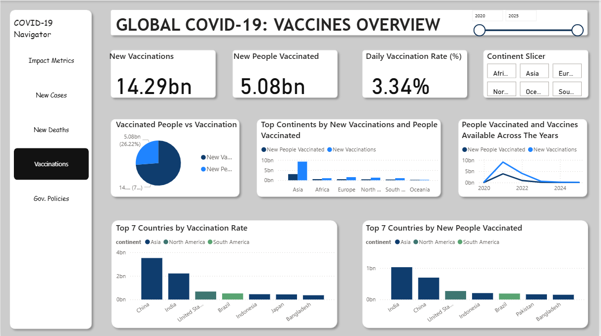
DASHBOARD PREVIEW

Slide 13
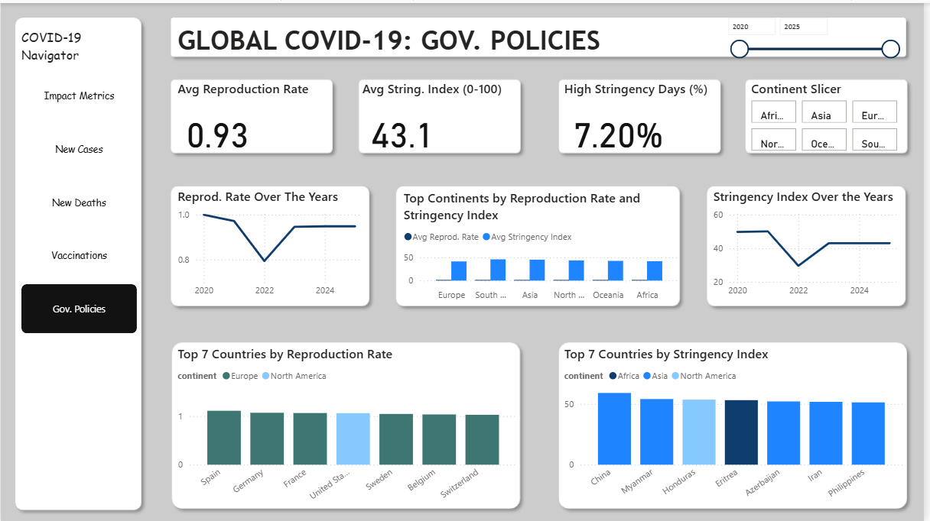
DASHBOARD PREVIEW

Slide 14
CONCLUSION
Vaccine availability exceeded uptake, indicating that supply was sufficient for prevention during the period analyzed.
Government policies were moderately strict overall, as reflected by an average Stringency Index of 42.9.
The low proportions of new cases (0.09%) and new deaths (0.07%) suggest a reduced frequency of new infections and fatalities.
A reproduction rate below 1 (0.93) indicates a declining transmission trend.
Countries with higher policy stringency also recorded higher case and death rates, suggesting that stricter measures were often implemented in response to rising infections rather than being the immediate cause of reduced outcomes.

